Slide 1
Module Seven: Hot topics in Service Computing - Cloud -

Slide 2
Topic 5: Private cloud platform construction

Slide 3
Intended learning outcomes
After completing this topic, you will be able to:
Use the cloud computing virtualization technologies
Construct private cloud platform
Be aware of private cloud disadvantages

Slide 4
Private cloud
A cloud computing environment in which all hardware and software resources are dedicated exclusively to, and accessible only by, a single party

Slide 5
Private cloud vs Public cloud (1)
Private cloud
dedicated to the needs and goals of a single organization
Public cloud
Delivers services to multiple organizations

Slide 6
Private cloud vs Public cloud (2)
Private cloud delivers similar advantages to public cloud, including scalability and self-service, but through a proprietary architecture
Private cloud is a single-tenant environment

Slide 7
Single-tenant environment
Tenant - the organization using the cloud
In single-tenant environment the tenant does not share resources with other users
What does it mean that the resources are not shared?

Slide 8
How are the resources hosted in private clouds?

Slide 9
Example
Let’s consider an example of an enterprise with multiple business units
Business need: data storage
Resource: private data center

Slide 10
How can the resources be hosted and managed?
Option 1 – private data center
Organization's on-premises data center
Owned and hosted on organization’s premises
Managed by organization

Slide 11
How can the resources be hosted and managed?
Option 2 – public cloud
Hosted by another organization on shared resources

Slide 12
How can the resources be hosted and managed?
Option 3 – private cloud
Hosted on resources dedicated to the organization (not shared)

Slide 13
Constructing a private cloud
Cloud infrastructure
components needed for cloud computing
the basic elements of cloud infrastructure are the same whether you have a private cloud, public cloud, or hybrid cloud.
Operating system+ a variety of bare-metal, virtualization, or container software that abstract, pool, and share scalable resources across a network.
The IT staff that is equipped to manage private cloud environments

Slide 14
How can the resources be hosted in private clouds?

Slide 15
On-Premise/Internal private cloud
Motivation
Better utilization of resources
Maintain full control
The private cloud is based on resources and infrastructure already present in an organization's on-premises data center
The organization/enterprise hosts a cloud environment internally

Slide 16
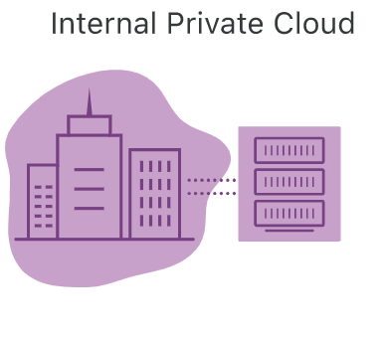
On-Premise/Internal private cloud
In this model, who is
Cloud provider/service provider?
Customer/user/cloud tenant?

Slide 17
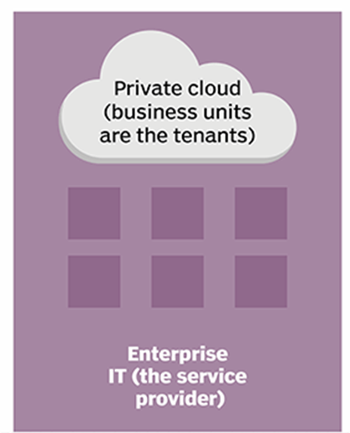
On-Premise/Internal private cloud
Infrastructure is owned and managed by the enterprise’s own IT team
Enterprise IT becomes the service provider
Enterprise’s business units use resources hosted in the private cloud
Business units are cloud tenants

Slide 18
On-Premise/Internal private cloud benefits
Very secure
internally hosted and managed by an organization’s internal IT department
the organization has complete control over the security, configurations, and scalability of its servers

Slide 19
On-Premise/Internal private cloud benefits
Higher cost
Can include the cost of purchasing and installing new hardware and software and the cost of managing it (which may involve hiring additional IT staff.)
Limited flexibility
once an organization invests in hardware and software for its private cloud, adding capacity or new capabilities requires additional purchases

Slide 20
How are the resources hosted in private clouds?

Slide 21
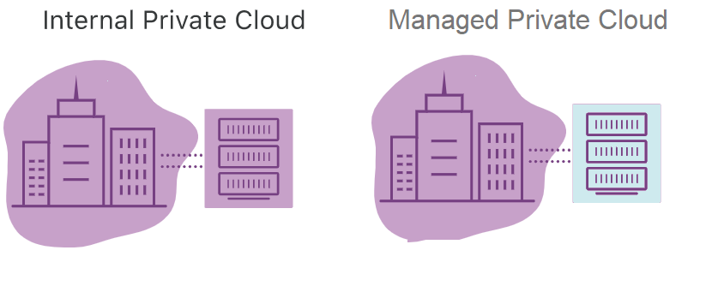

Slide 22
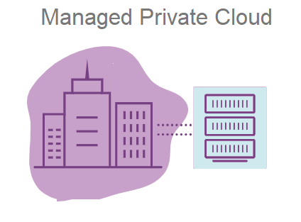
Managed
Responsibility for managing and maintaining the infrastructure is outsourced to a third-party service provider.
The physical hardware
usually resides in the service provider’s data center
vendors also offer management services for infrastructure located in an enterprise’s own data center
The provider maintains every part of the cloud for the enterprise, including the deployment of additional services like identity management and storage.
A good alternative for companies that don‘t have the resources to run private cloud systems on their own.

Slide 23
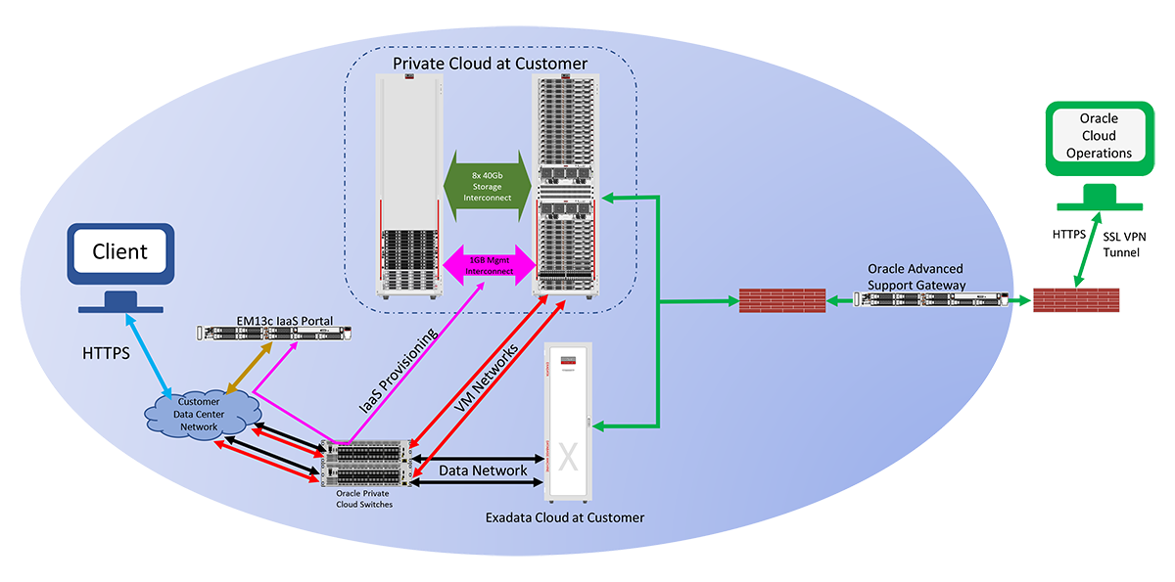
Example - Oracle Private Cloud at Customer
Infrastructure managed by Oracle but deployed inside inside customer own data centers

Slide 24
Architecture of Oracle Private Cloud at Customer
A web-based self-service management interface gives the customer interactive access to service administration functions
Oracle monitors and manages the infrastructure components
the physical compute node hardware
network switches
power distribution units (PDUs)
Oracle Integrated Lights Out Manager interfaces (ILOMs)
the storage
These operations are performed remotely by Oracle using the Oracle Advanced Support Gateway

Slide 25
Manage private cloud example – Atlantic.Net
Atlantic.Net's Managed Virtualization
provides a managed private cloud hosting solution
utilizes enterprise-level hardware running industry standard hypervisor software

Slide 26
Services offered in managed private cloud
System Environment
Clustering
VM Provisioning
System Updates
Replication and Failover
Advanced Certifications
Advanced Monitoring
Additional VM Services
Managed Private Cloud Infrastructure

Slide 27
System Environment
Up-to-OS management and support
Active administration of host server resources, including CPU, network, and hard disk utilization

Slide 28
Clustering
Offers the ability to migrate VM to another host server in case of system failure or load balancing between servers
Allows for redistribution of Virtual Machines amongst multiple host servers and the ability to configure a shared storage node to provide VM Hypervisor management and automated failover of a clustered computing node
This is done by increasing memory/CPU per computing node, since VM hard disks are located on a shared storage

Slide 29
VM Provisioning
VM creation, cloning, and removing
Initial private networking setup and VLAN tagging (to segment traffic between individual VMs)
A self-service portal enables customers to start, stop, and console in to any configured VM

Slide 30
System Updates
Prior to updating the host server, each new update is reviewed and tested to ensure that there are no issues with the system
Any necessary restarts will be scheduled
Hyper-V deployments make use of cluster aware updating, ensuring 100% uptime while updating each node in the cluster.

Slide 31
Replication and Failover
Virtual Machine replication is designed to provide cross-node fault tolerance by increasing the necessary storage, memory, and CPU requirements for a separate dedicated computing node

Slide 32
Advanced Certifications
Microsoft Certified Professionals, and Red Hat Enterprise Linux Certified Engineers on staff to assist with all VM design, configuration, and deployment

Slide 33
Advanced Monitoring
Service provider will ensure the hardware, virtualization hypervisor, and all VMs are always functioning properly
If the customers encounter an issue relating to OS-level or system configuration, our certified professionals can assist you under a consulting agreement

Slide 34
How are the resources hosted in private clouds?

Slide 35
Hosted private cloud

Slide 36
Hosted private cloud
The private cloud is based on new, separate infrastructure, which is provided by a third-party organization
The environment where infrastructure is both hosted and managed by the cloud provider itself

Slide 37
How hosted private cloud works
The cloud provider allocates a particular server to a particular organization
The server’s resources are not shared among other organizations
The organization only uses the resources and can access them as per the demand
The cloud provider is responsible for managing, updating, and configuring the hardware, software, and network

Slide 38
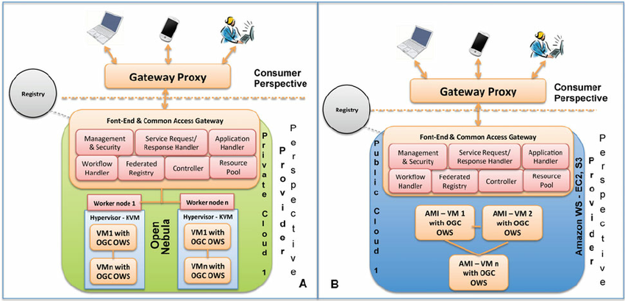
Hosted private vs public cloud

Slide 39
Hosted private vs public cloud (2)
From the customer perspective both options have some similarity- the service provider configures the network, maintains the hardware and updates the software
However, in a hosted private cloud environment, the servers are not shared with other organizations

Slide 40
Hosted private cloud benefits
Hosted private cloud vendors offer cloud servers in their own data centers and are also responsible for security management
Users get access to
additional resources
a support team
high-demand scalability options
a user-friendly dashboard to assist in server management

Slide 41
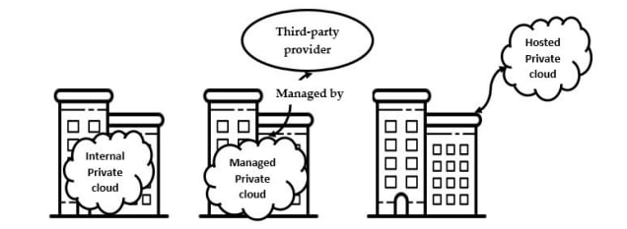
Internal vs Managed vs Hosted

Slide 42
How are the resources hosted in private clouds?

Slide 43
Virtual private cloud
A secure private cloud that is hosted remotely by a public cloud provider
The single-tenant environment is enabled solely using virtualization software

Slide 44
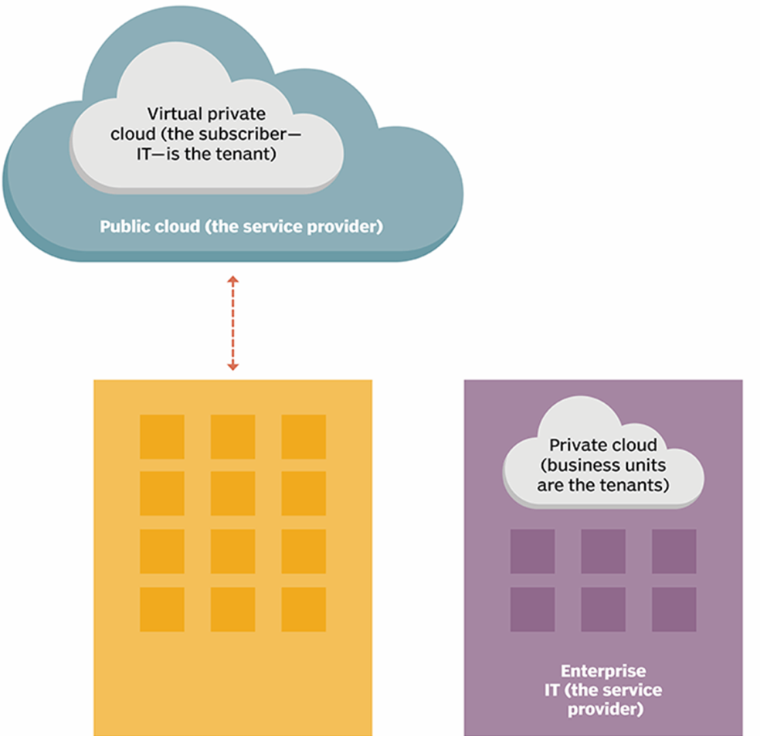
Virtual private cloud
A walled-off environment within a public cloud that allows an organization to run their workloads in isolation from every other user of the public cloud
Even though the server is shared by other organizations, the virtual logic ensures that a user's computing resources are private

Slide 45
Virtual private cloud benefits
VPC customers can benefit from the public cloud’s
Resource availability
Scalability
Flexibility
Cost-effectiveness
Retaining much of the security and control of private cloud
The ability to define and control a logically isolated space in the public cloud
Offers the private cloud’s enhanced security within a multi-tenant environment

Slide 46
How to create a virtual private cloud - example
VMware vCloud® Air™ Virtual Private Cloud OnDemand
Create an Account
Create a Virtual Machine
View and Monitor Resource Usage

Slide 47
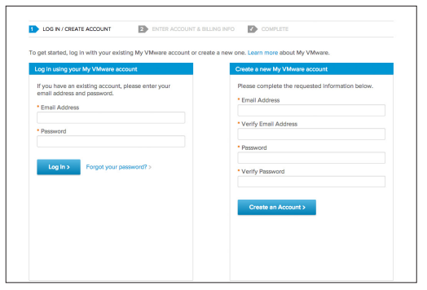
Create an account
a browser
a credit card

Slide 48
Create a Virtual Machine
When you log in to Virtual Private Cloud OnDemand the first time, a virtual data center named “VDC1” is automatically created with a routed network and gateway
A virtual data center is an environment in which virtual machines are stored, deployed, and operated
You can create one or more virtual data centers to expand your capacity limits exponentially and to organize resources into more-manageable chunks.
You can change the name of a virtual data center or delete it (and its associated virtual machines).

Slide 49
Create a Virtual Machine
To create your first virtual machine, simply click Create Your First Virtual Machine, and a wizard walks you through an easy two-step process:
Select a virtual machine
Select your desired resources

Slide 50
Select a Virtual Machine
Select a predefined template
Create an original virtual machine

Slide 51
Predefined template
Select a predefined template
from the VMware Public Catalog - an operating system and application catalog of commonly used, preconfigured workloads
from a list of your catalogs that have been uploaded under My Catalog

Slide 52
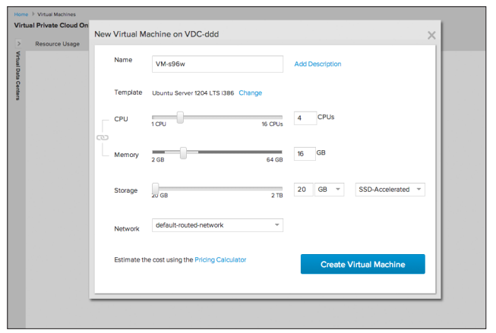
Select desired resources
Use the wizard’s slide scale to select your desired CPU, memory, storage, and network connection
You can adjust the CPU, memory, and storage resources of any virtual machine on the fly
Simply select the virtual machine you want to change and select Edit Resources from the Actions menu.

Slide 53
Create an original virtual machine
If you don’t want to create a virtual machine based on a template, you can create an original virtual machine in VMware vCloud Director®
Select Create My Virtual Machine from Scratch, which routes you to create a vSphere vApp™ and its virtual machines

Slide 54
View and Monitor Resource Usage
You can view resource usage data
for all virtual machines in a virtual data center
for specific virtual machines
Data is aggregated to display
monthly totals for storage usage
hourly totals for vCPU, vRAM, public IP addresses, and license usage
You can view resource usage by
month to date
the past 24 hours
the past hour
Enables you to pay for only the resources you use, on a per-minute, metered basis

Slide 55
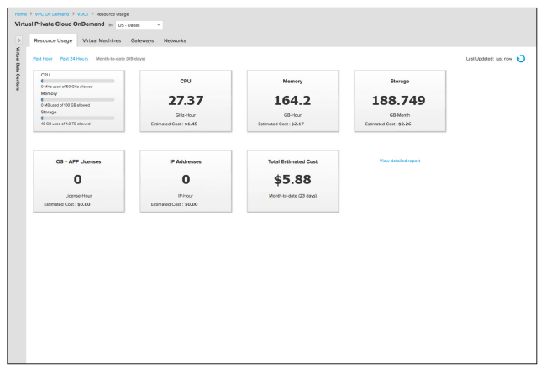

Slide 56
Types of private clouds
Virtual
Hosted
Managed
On-premise/Internal
All private clouds offer an isolated environment
Different types of private clouds are classified into categories based on how they are hosted and how much management they receive from the provider

Slide 57
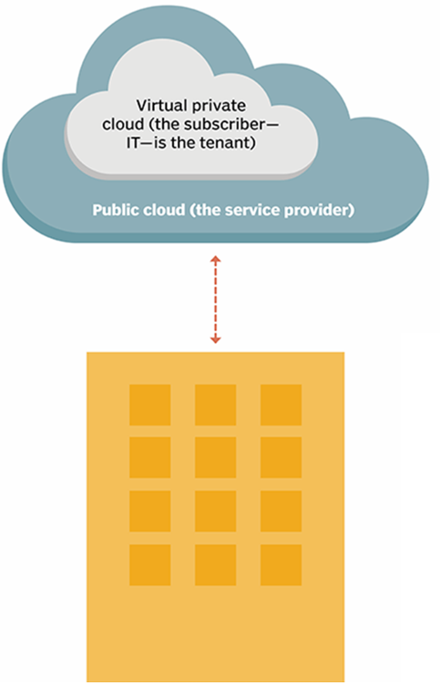
Private cloud types

Slide 58
Types of private clouds

Slide 59
Constructing a private cloud
Cloud infrastructure
components needed for cloud computing
the basic elements of cloud infrastructure are the same whether you have a private cloud, public cloud, or hybrid cloud.
Operating system+ a variety of bare-metal, virtualization, or container software that abstract, pool, and share scalable resources across a network.
The IT staff that is equipped to manage private cloud environments

Slide 60
Private cloud - a virtualized pool of resources
To enable multiple workloads to run on the same physical server, we need to virtualize the resources
We will use virtualization software to achieve that

Slide 61
Example - setting up a virtual machine server

Slide 62
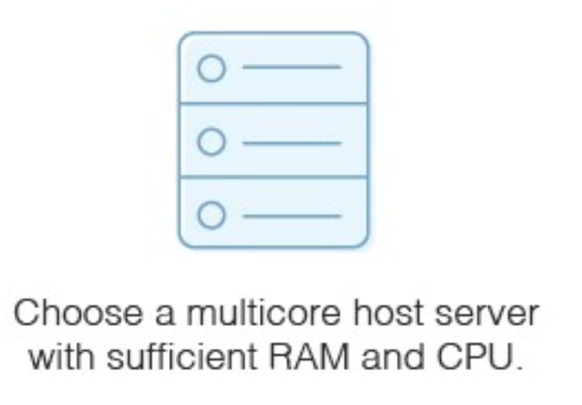
Physical hardware
Physical hardware with appropriate resources
The capacity of your physical host machine matters
each VM will need RAM and CPU

Slide 63
Storage
Necessary if you don’t have a storage area network for the virtual server images
The host server will need sufficient disks to hold this storage
SATA drives
SAS drives

Slide 64
Hypervisor
Use virtualization software (hypervisor) to set up virtual machine server
Hyper-V
Vmware
VirtualBox
Citrix XenServer
Hypervisor types
bare-metal hypervisors
installed directly on the hardware
may run slightly faster, but they’re a bit trickier to set up and use than a hosted hypervisor
hosted hypervisors
installed on an already-existing operating system installed on the host machine
Follow the instructions on the hypervisor itself to set up and provision a virtual server. Hosted hypervisors are much like any computer application because they have a setup wizard with easy instructions.

Slide 65
Configure Virtual Machines
Check the default values for the virtual machine to ensure it will suffice for your purposes
Choose
What guest operating system you want to run
Where the virtual machine’s files will be stored
The types of network connection you want to set up for the virtual machine
Decide whether to allocate all the disk space for the virtual machine when you create it, or whether you want it to take disk space dynamically as needed.
You can configure three types of virtual machine resources
Hardware it has access to
Power management operating system options
Resource configuration
CPU configuration
Hyperthreading
Disk settings
Memory

Slide 66
Example - setting up a virtual machine server

Slide 67
Private Cloud Solutions
Allow companies to architect a data center using software-defined networking (SDN) and virtualization (VMs)
Private cloud solutions come from
proprietary software developers like Microsoft, VMware, and Nutanix
enterprise-grade open source solutions available from Red Hat and others

Slide 68
VMware Private Cloud
VMware - a leading international cloud infrastructure company
provides virtualization solutions since 1998
VMware Private cloud - a virtualized pool of resources allocated on-demand
Private cloud is able to easily switch between virtual machines to keep everything running
It can also create endless virtual machines based on your underlying hardware

Slide 69
VMware vSphere®
Uses virtualization to transform data centers into simplified cloud computing infrastructures

Slide 70
VMware vSphere®
The two core components
VMware ESXi™
The hypervisor on which you create and run virtual machines
VMware vCenter Server®
A service that acts as a central administrator for ESXi hosts that are connected on a network

Slide 71
Physical Topology of vSphere Data Center
A typical VMware vSphere data center consists of physical building blocks such as
x86 virtualization servers - ESXi Hosts
storage networks and arrays
IP networks
a management server - vCenter Server
desktop clients

Slide 72
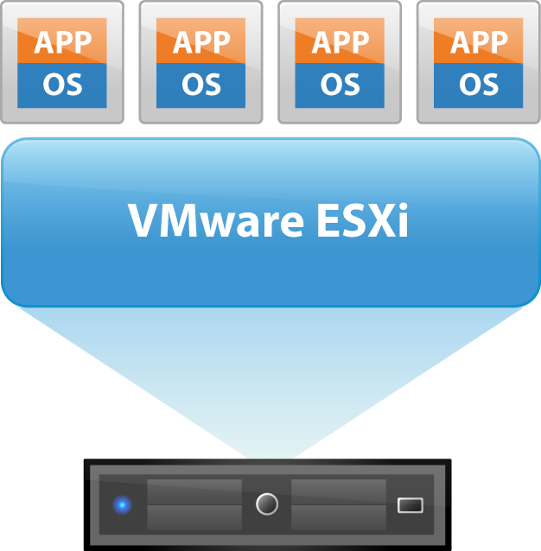
ESXi - the hypervisor in a vSphere environment
Installed on physical or virtual hardware in a virtualized data center, and acts as a platform for virtual machines
Provides physical hardware resources dynamically to virtual machines to support the operation of the virtual machines
Allows virtual machines to operate with a degree of independence from the underlying physical hardware
For example, a virtual machine can be moved from one physical host to another, or its virtual disks can be moved from one type of storage to another, without affecting the functioning of the virtual machine

Slide 73
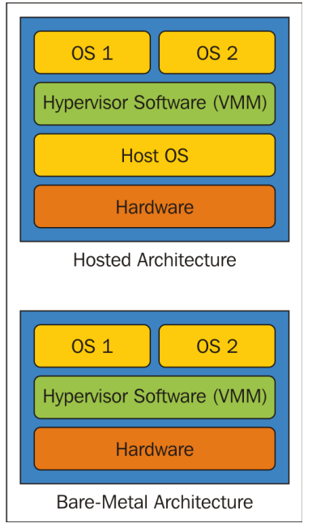
Hypervisor types

Slide 74
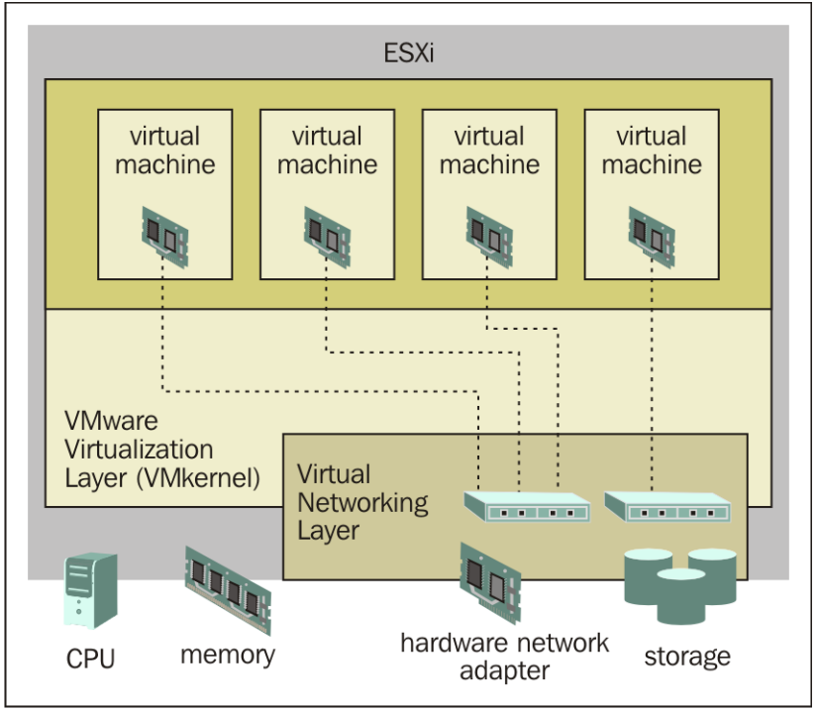
ESXi
An enterprise-class, type-1 hypervisor (bare-metal)
As a type-1 hypervisor, ESXi is not a software application that is installed on an operating system (OS)
Instead, it includes and integrates vital OS components, such as a kernel

Slide 75
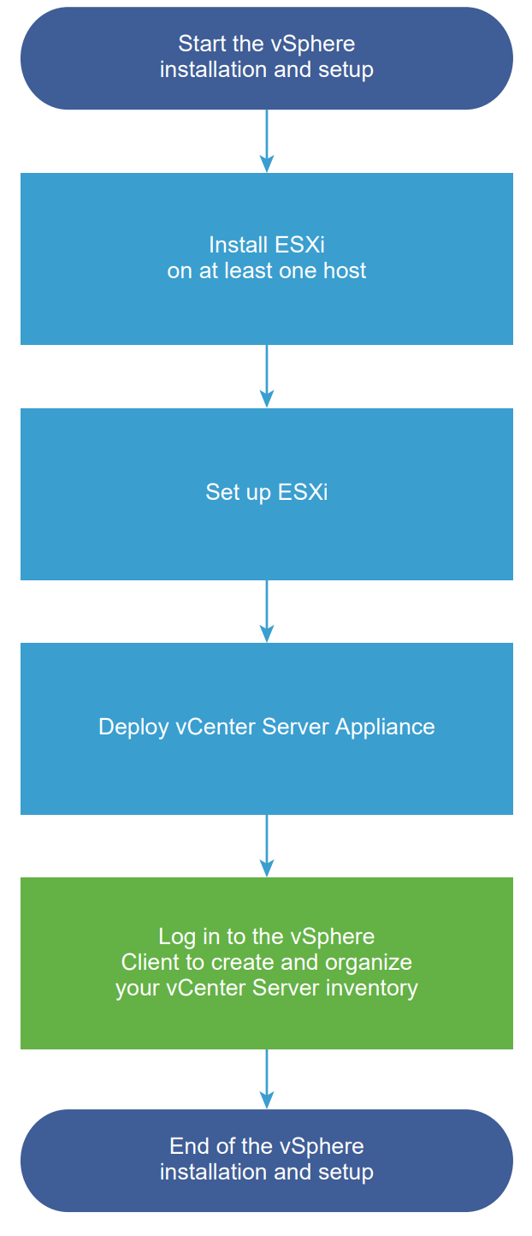
VSphere installation and setup
You can install and set up ESXi on your physical hardware so that it acts as a platform for virtual machines
After ESXi is installed and set up, you can manage the host by using the vSphere Client and vCenter Server, license the host, and back up your ESXi configuration
You can also use the VMware Host Client to connect directly to the ESXi host and to manage it

Slide 76
The vCenter Server appliance
The vCenter Server appliance is a preconfigured virtual machine that is optimized for running vCenter Server and the associated services

Slide 77
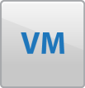


vCenter Server (1)
vCenter Server provides a single point of control to the data center
You can pool and manage the resources of multiple hosts
It unifies the resources from the individual computing servers to be shared among virtual machines in the entire data center
It provides essential data center services such as
Access control
Performance monitoring
Configuration
VMware vCenter Server

Slide 78
vCenter Server (2)
Allows you to monitor and manage your physical and virtual infrastructure
It manages the assignment of virtual machines to the ESXi hosts and the assignment of resources to the virtual machines within a given computing server
These assignments are based on the policies that the system administrator sets
VMware vCenter Server

Slide 79
vCenter Server (3)
A single point of control doesn’t mean a single point of failure
Compute servers continue to function even if vCenter Server becomes unreachable (for example, if the network is severed)
The ESXi hosts can be managed separately and continue to run the virtual machines assigned to them based on the resource assignment that was last set
After connection to vCenter Server is restored, it can manage the data center as a whole again
VMware vCenter Server

Slide 80
Constructing a private cloud
Cloud infrastructure
components needed for cloud computing
the basic elements of cloud infrastructure are the same whether you have a private cloud, public cloud, or hybrid cloud
Operating system+ a variety of bare-metal, virtualization, or container software that abstract, pool, and share scalable resources across a network
The IT staff that is equipped to manage private cloud environments

Slide 81
Cloud engineering professionals
Cloud engineer
Cloud architect

Slide 82
Cloud architect role
Creating a well-informed cloud strategy and managing the adaptation process
Evaluating cloud applications, hardware, and software
Designing and implementing cloud computing solutions
designing the cloud infrastructure
designing the cloud application architecture
designing the cloud security architecture

Slide 83
Cloud professionals key skills
Know the language of business and domain knowledge
Understand the conceptual, logical and physical architecture
Master various cloud technologies, frameworks, and platforms
Implement the solutions for quality of cloud services
Work on the security at multiple levels
Develop applications for flexible deployment, provisioning, and management
Leverage open source packages and products
Apply agile and lean principles in design and construction

Slide 84
Cloud professionals technical skills
Good knowledge of at least one operating system
Linux, Unix, Solaris, Ubuntu, Windows
Good understanding of networking
TCP/IP, IP addresses, HTTP, DNS
Computer programming languages
at least a minimal understanding of a programming or scripting language (helpful)
Security
a high-level understanding of key security concepts, initial knowledge of some basic security concepts, such as firewalls

Slide 85
Certified Cloud Architect - AWS
AWS Certified Solutions Architect – Associate
This certification validates technical expertise in designing and deploying systems on the AWS platform

Slide 86
Certified Cloud Architect – Microsoft Azure
Microsoft Azure Solutions Architect
The certification requires expertise in compute, network, storage, and security to design solutions that run on Azure
Two exams:
AZ-300 Exam: Technologies for Microsoft Azure Architects
AZ-301 Exam: Designing a Microsoft Azure Architecture

Slide 87
Choosing cloud deployments
Public cloud?
Private cloud?
Hybrid cloud?

Slide 88
Making the choice to adopt private cloud
Choosing private cloud over public mainly boils down to two things
budgeting (choosing CAPEX over OPEX)
control (in terms of security and privacy)

Slide 89
Budgeting
Capital Expenditures (CapEx)
Purchases of significant goods or services that will be used to improve a company’s performance in the future
Manufacturing plants, equipment, and machinery
Building improvements
Computers
Vehicles and trucks
…
Operating Expenses (OpEx)
The costs that a company incurs for running its day-to-day operations
Rent and utilities
Wages and salaries
…

Slide 90
Budgeting issues
Which cloud costs more?
You usually pay for what you use in a public cloud, though some public clouds don't charge tenants.
Whoever set up a private cloud is usually responsible for purchasing or renting new hardware and resources to scale up
Hybrid clouds can include any on-premises, off-premises, or provider's cloud to create a custom environment that suits your cost requirements

Slide 91
Budgeting issues
Which cloud has the best resources?
That depends on how you want to spend money. Do you want to incur capital expenses (CapEx) or operating expenses (OpEx)? This is the classic scale-up vs. scale-out question.
Public cloud users seem to have unlimited access to resources, but accessing those resources is usually an operational expense.
Deploying more private cloud resources requires buying or renting more hardware—all capital expenses.
Hybrid clouds give you the option of using operating expenses to scale out or capital expenses to scale up

Slide 92
Control issues
Which cloud is safest?
Public clouds
Tend to have a wider variety of security threats due to multi-tenancy and numerous access points
Often split security responsibilities
infrastructural security can be the provider’s responsibility
workload security can be the tenant's responsibility
Private clouds
Are thought to be more secure because workloads usually run behind the user's firewall
All depends on how strong the user’s own security is
Hybrid cloud
security is made up of the best features of every environment
users and admins can minimize data exposure by moving workloads and data across environments based on compliance, audit, policy, or security requirements

Slide 93
Summary
All private clouds offer an isolated environment but differ on how they are hosted and how much management they receive from the provider
Private clouds are based on the same technologies as public and hybrid clouds
Before adopting cloud technology, companies need to first develop a migration strategy in which they define their needs, expectations, and goals

